Slide 2
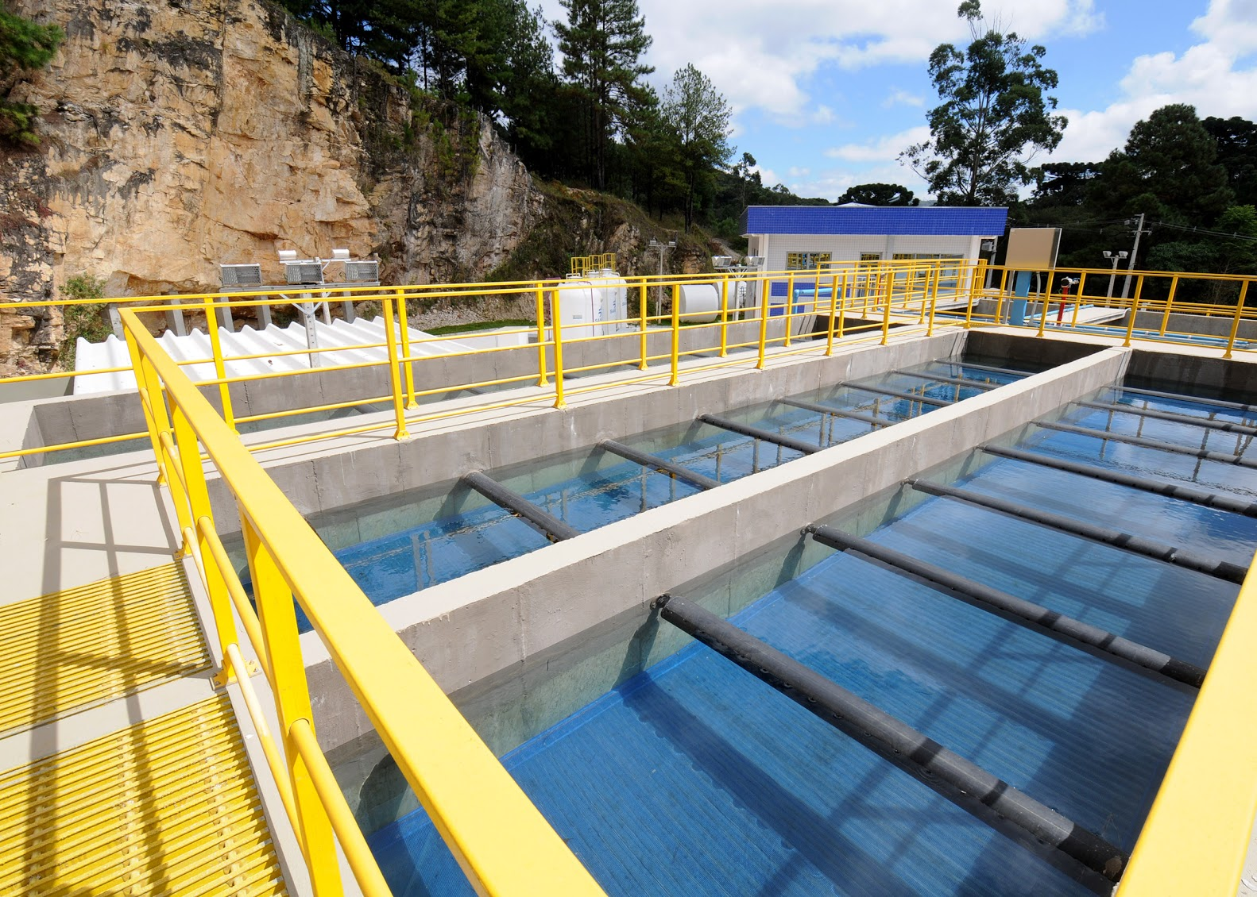
SANEPAR
Sanepar provides services of water treatment, sewage collection and treatment, selective waste collection and disposal.

Slide 3
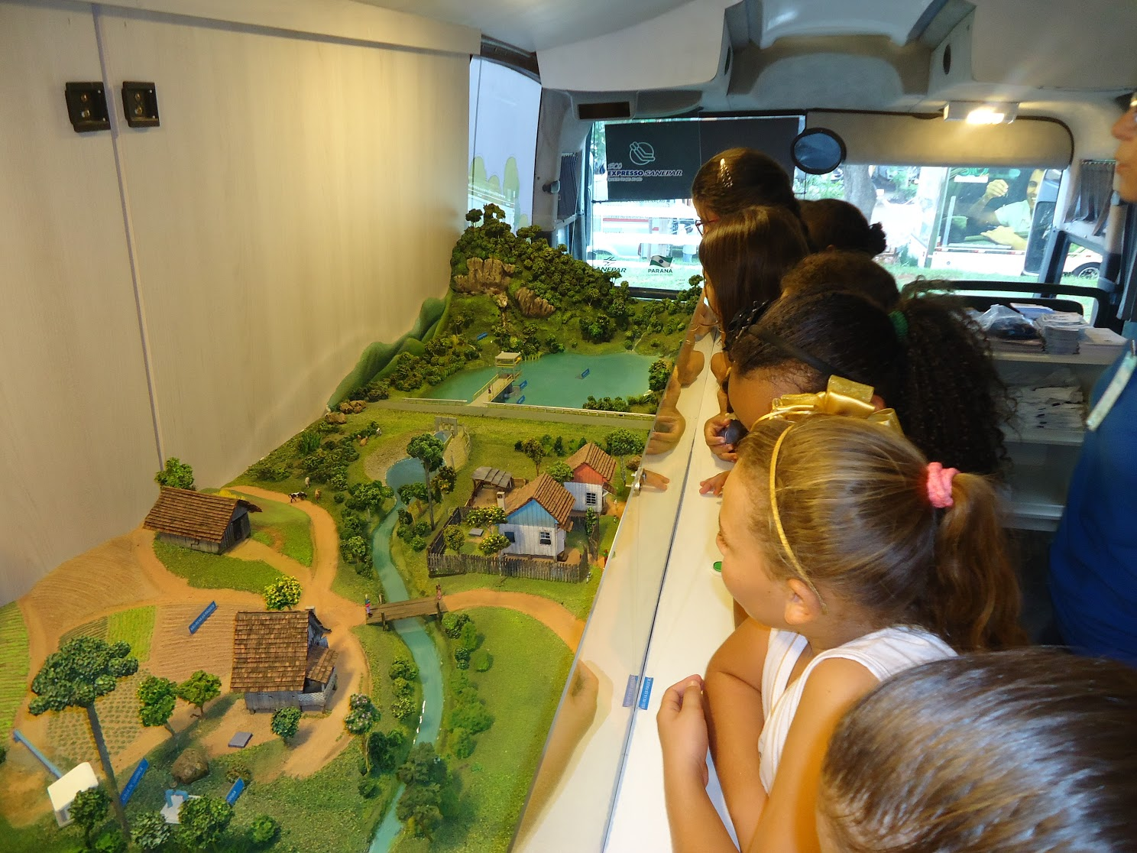
SANEPAR
MISSION
Provide environmental sanitation services in a sustainable way, contributing to improve quality of life.

Slide 4
SANEPAR
Strategic map
Strategic objectives
Sustainability
Seek economic-financial and socioenvironmental sustainability
Clients
Maintain and expand the market covered
Promote the universalization of environmental sanitation
Improve customer satisfaction
Strengthen the company's image
Processes
Invest in institutional development
Improve efficiency in processes
Seek excellence of products and services
Ensure environmental management
People
Advance knowledge management
Promote people's satisfaction
Act with environmental responsibility

Slide 5
SANEPAR’s
coverage area
MUNICIPALITIES SUPPLIED IN PARANÁ
AND 1 TOWN IN SANTA CATARINA
MUNICIPALITIES SUPPLIED IN PARANÁ
CURITIBA
PORTO UNIÃO / TOWN SUPPLIED IN SANTA CATARINA

Slide 6
SANEPAR
in numbers
Água
Esgoto
3,7 millions*
Active economies¹
2,5 millions*
Active economies¹
100%
Network supply index
67,13%
System coverage index
99,5%
Treatment index
2.979.363
Connections
1.859.533
Connections
49,6 thousand km
Extension of the water supply network
31 thousand km
Extension of the sewage system
¹ The term active economy is used to refer to any property or subdivision of a property that has a private installation or common use of water or sanitation registered and charged by Sanepar.

Slide 7
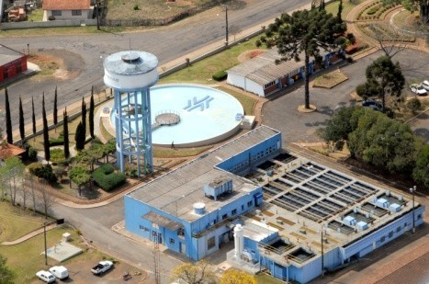
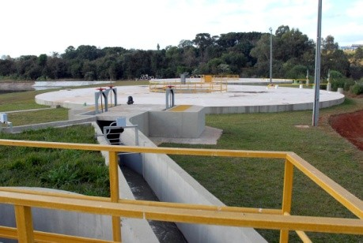
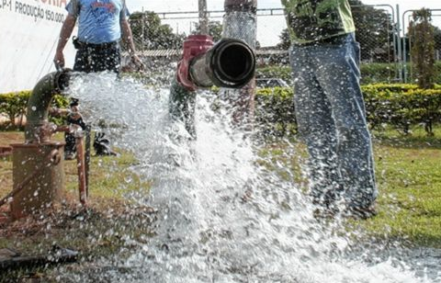
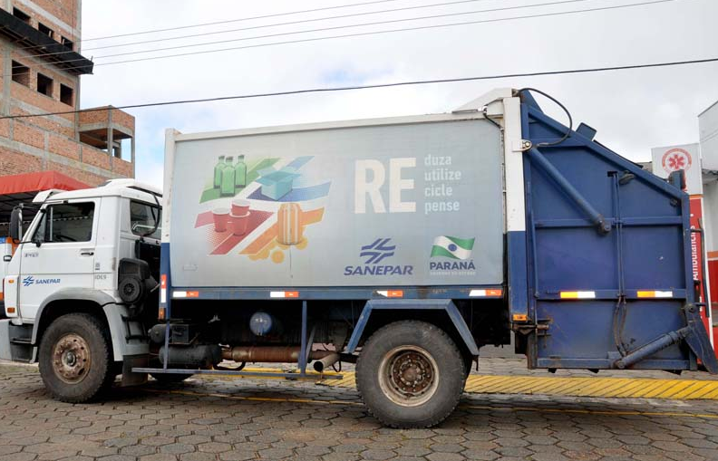
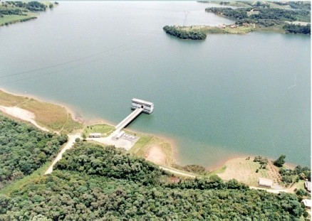
SANEPAR
in numbers
Water treatment plants | WTPs
Sewage treatment plants | STPs
Wells
Landfill sites
Dams
170
234
1.027
3
4

Slide 8
SANEPAR
in numbers
2011 TOTAL INVESTIMENT | 2012 TOTAL INVESTIMENT | 2013 TOTAL INVESTIMENT | 2014 TOTAL INVESTIMENT | 2015 TOTAL INVESTIMENT | TOTAL TOTAL INVESTIMENTS
WATER 123,7 MILLIONS | WATER 208,6 MILLIONS | WATER 348,4 MILLIONS | WATER 408,6 MILLIONS | WATER 300,4 MILLIONS | WATER 1,4 BILLION
SEWAGE 207,1 MILLIONS | SEWAGE 240,6 MILLIONS | SEWAGE 361,5 MILLIONS | SEWAGE 468,0 MILLIONS | SEWAGE 446,8 MILLIONS | SEWAGE 1,7 BILLION
OTHERS 23,4 MILLIONS | OTHERS 26,2 MILLIONS | OTHERS 77,2 MILLIONS | OTHERS 77,4 MILLIONS | OTHERS 47,8 MILLIONS | OTHERS 252,9 MILLIONS
TOTAL 354,2 MILLIONS | TOTAL 476,3 MILLIONS | TOTAL 787,0 MILLIONS | TOTAL 954,0 MILLIONS | TOTAL 795,0 MILLIONS | TOTAL GENERAL 3,3 BILLIONS

Slide 9
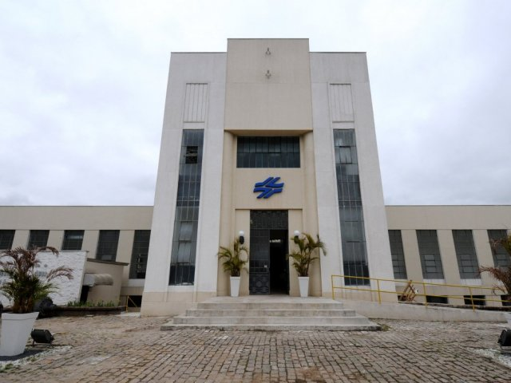
SANEPAR Sustainable Technology Center (CETS)
CETS was established in 2014 to provide innovative technological solutions for the company. It has pilot treatment units, labs, infrastructure for meetings and research, library and the Continents Room – which is destined to integrate international partner institutions.

Slide 10
Administrative Headquarters
1376 Engenheiros Rebouças St.
Rebouças, Curitiba, Paraná State, Brazil
Zip Code 80215-900
Phone (55) (41) 3330 3000 | 0800 200 0115

